Slide 1
LEYAK GAME
“Leyak” Game
This Photo by Unknown Author is licensed under CC BY-NC

Slide 2
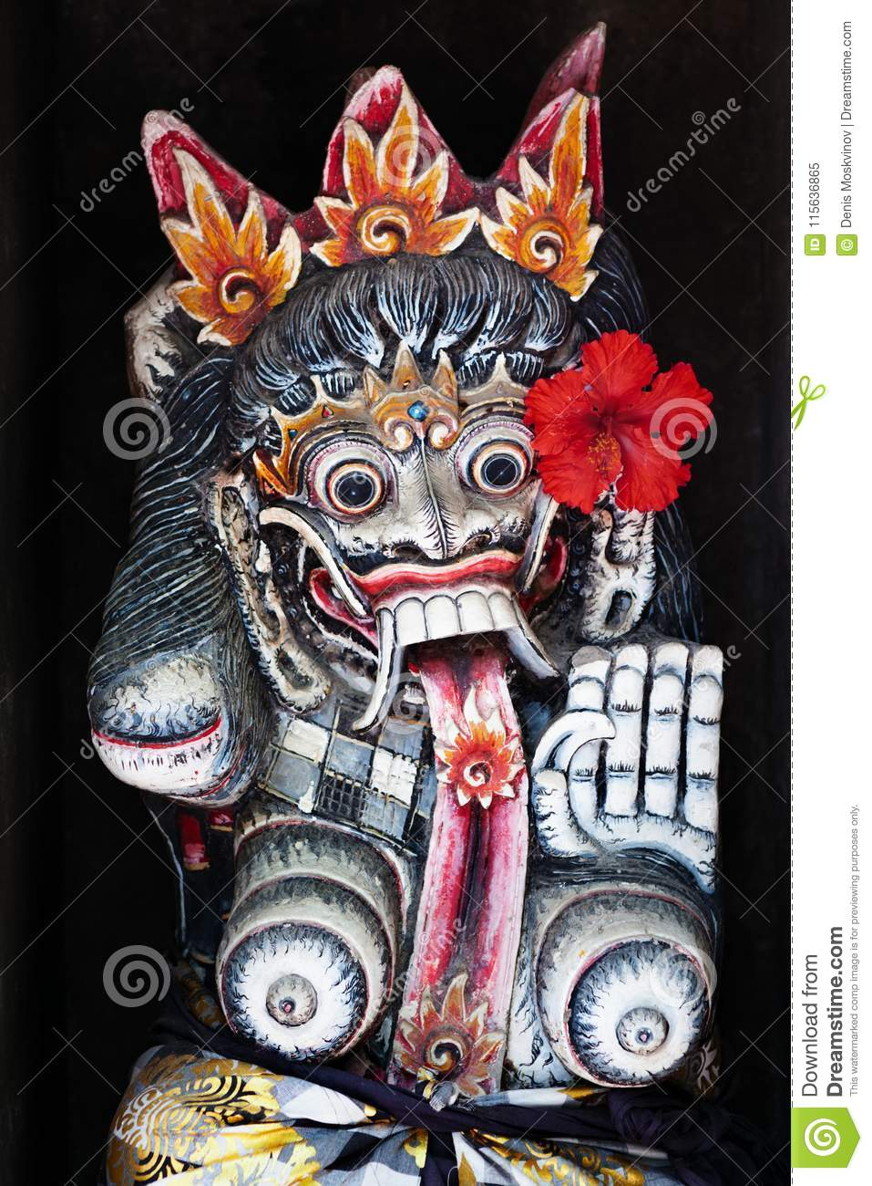
Ini Leyak
This Photo by Unknown Author is licensed under CC BY
Notes:
Explain, describe the cultural element of “Leyak”

Slide 3
Leyak - A Balinese Monster
Leyaks are monsters who appear human in the daytime, but at night… they become scary creatures that have unusually long tongues and fangs. They are similar to vampires and will drink blood.
They are said to haunt graveyards and feed on corpses.

Slide 4
Key Vocabulary
Penjahat/Leyak – Evil person/Balinese monster
Polisi – Police
Dokter – doctor
Orang desa – village people/person
Bangun – to wake up
Tidur – to sleep
Saya pikir leyak (insert name) karena….. – I think (insert name) is the leyak, because….
Menyelamatkan = to save
Mati = to die

Slide 5
Skenario…
Di desa, ada dua leyak, satu polisi dan satu dokter.
Pada suatu hari, leyak membunuh seorang.
Siapa leyak…????
Notes:
Adapt this to the number of students
9-12 students: Cards for 2 assassins, 1 police and 1 doctor; remaining cards for townspeople.
12-18 students: Cards for 2 assassins, 2 police and 1 doctor; remaining cards for townspeople.
18-25 students: Cards for 3 assassins, 3 police and 2 doctors; remaining cards for townspeople.
25 students and up: Cards for 4 assassins, 4 police and 3 doctors; remaining cards for townspeople.

