Slide 1

Being Language Detectives
Dictionary Skills

Slide 2
Today’s Goal
By the end of this lesson, you will be able to:
Identify what is a meN- verb
To identify base words
To use a dictionary

Slide 3
Why are dictionary skills useful?
You can become more independent in looking up words you don’t know.
You can learn new words.
You can make up silly sentences!

Slide 4
So let’s look at some examples. What is the pattern?
Base word: play
Bermain: to play
Pemain: the player
Pemainan: the game

Slide 5


How does a dictionary work??
How does a BILINGUAL dictionary work?

Slide 6
meN+ words
Working out the base word
Look
Look at the affix attached to the beginning.
Compare
Compare to Me-Verbs table.
Look at the example word.
Identify
Identify base word.
Check whether or not a letter is dropped.
Look up
Look up base word in dictionary.
Look for bold version of the word, and it will tell you the meaning

Slide 7
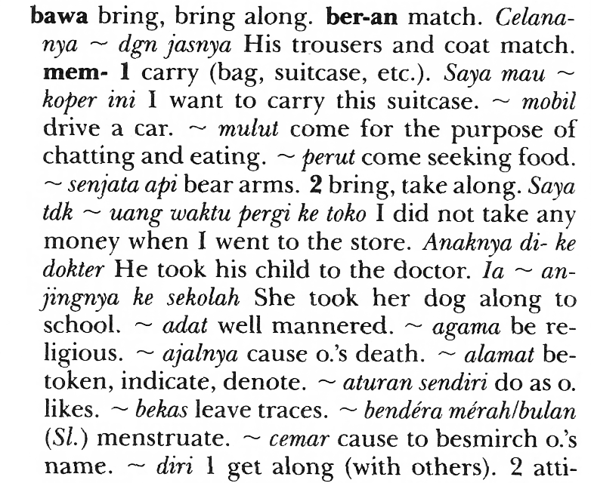

Slide 8

membUANG
Look
Look at the affix attached to the beginning. Identify which prefix is being used.
Compare
Compare to Me-Verbs table. Look at the example word
MEMbuang Vs MEMbantu.
Identify
Identify base word.
Check whether or not a letter is dropped.
Look up
Look up base word in dictionary. Look for bold version of the word, and it will tell you the meaning
MEMbuangi
BUANG
BUANG-> throw
MEMBUANG= to throw away

Slide 9
Let’s Practice
Work out the following base words:
Membaca
Mendengarkan

Slide 10
Language Detective
You have been given the case of deciphering the code for

Slide 11
Siap…? Ayo!

Slide 12
Dictionary Race
MENGhitamKAN
MEnanti
MENYapa
menUNGGU
tinggalKAN
kerjaAN

Slide 13
Bonus question
What other affix did you notice attached to these base words?

Slide 14
Hints on How to Use it Effectively
Know your affixes, especially “me-” verbs, so it makes it easier to identify base words.
Look at the example sentences to gain a stronger grasp of how the word is used.
Imitate those sentences in your own writing if possible.
Do not look up every single word you don’t know that you read in a text.
Practice identifying key terms in writing.

